Slide 1
KCNSC Subcontractor
HS&E and Security Site Orientation
Trae Q L Venerable
HS&E Engineer
Construction Safety Engineer
August 12, 2025
NSC-614-6792 Unclassified Unlimited Release

Slide 2
Contractor Site Orientation Instructions
For all contractors (administration, consultation work, or vendors) complete the:
  HS&E and Security sections (Sections I & II)
For work requiring LOTO:
  Review the section for LOTO. (Section IV)
For work requiring Confined Space:
  Review the section on confined space. (Section V)
Construction contractors complete: (All Sections)
  The HS&E and security sections.
  LOTO and Confined Space.
  Construction Safety Requirements.
NSC-614-6792 Unclassified Unlimited Release

Slide 3
Section 1
General HS&E Requirements
This Section Required for all contractors
NSC-614-6792 Unclassified Unlimited Release

Slide 4
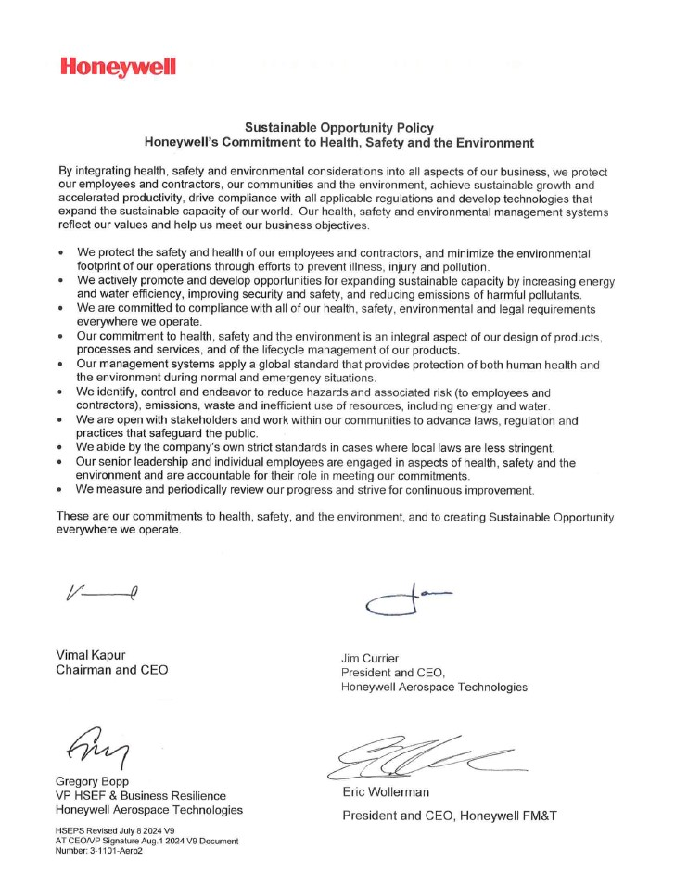
NSC-614-6792 Unclassified Unlimited Release

Slide 5
Our Commitment to Health, Safety & Environment
HSE Policy
Our health, safety and environmental management systems reflect our values and help us meet our business objectives
We are committed to compliance with all of our health, safety, environmental and legal requirements everywhere we operate
We abide by the company’s own strict standards in cases where local laws are less stringent
Our senior leadership and individual employees are accountable for their role in meeting our commitments
Accessible & communicated to KCNSC contractors & interested parties
Posted at each KCNSC facility & on the KCNSC Portal HSE page
Communicated to all New Employees & annually thereafter to all employees
Endorsed by Sr. Leadership
Protecting employees, our communities, and the environment
NSC-614-6792 Unclassified Unlimited Release

Slide 6
Department of Energy Differing Professional Opinions Process
The Department of Energy requires its contractors ensure that all subcontractor employees are notified annually that they have the right to report environment, safety, and health technical concerns that have not been resolved through routine work processes through the Department of Energy Differing Professional Opinion (DPO) process.
The DPO process can be found in DOE O 442.2, Contractor Requirements Document
https://www.directives.doe.gov/directives-documents/400-series/0442.2-BOrder-chg1-pgchg/@@images/file
Information regarding the DPO Process Description, DPO submittal form, and the DPO Manager list may be found on the DOE web site
https://www.energy.gov/ehss/doe-differing-professional-opinions
NSC-614-6792 Unclassified Unlimited Release

Slide 7
National Security Campus Plant Layout
01 02 03 04 05 06 07
The KCNSC layout is in a grid pattern, numbers run from west to east, letters from south to north.
Post location D04 is marked on the grid to the right.
Use these post locations to tell others your location in the plant.
Additional letters placed ahead of the post location are used to identify buildings and floors such as 02.1.D04 would be building 2, 1st floor, post D04.
G
F
E
D
C
B
A
NSC-614-6792 Unclassified Unlimited Release

Slide 8
Emergency Procedures
Evacuations / Sheltering
  Listen for announcements on the public address system for one of two types of emergencies:
    Sheltering – Go to designated shelters within the building. (Storms or external chemical release.)
    Evacuation – Exit the plant by following the exiting group to an external gathering space, usually in the parking lots.
  Maps identifying sheltering areas are posted at major plant intersections.
NSC-614-6792 Unclassified Unlimited Release

Slide 9
Emergency Procedures Cont’
Accidents
  All work related injuries are to be reported to KCNSC through either:
    Your company’s chain of management,
    Directly to your KCNSC contract representative, or HS&E at 816-488-3181
NSC-614-6792 Unclassified Unlimited Release

Slide 10
Emergency Information
KCNSC Emergency phone number is 911 at the KCNSC Bott’s Campus, Buildings 20 and 23.
This is a direct line to KCNSC Security.
Use for any medical, fire, or other emergency situation.
KCNSC Security will contact local fire and ambulance, if required.
Lines are manned 24 hours a day, 7 days a week.
NSC-614-6792 Unclassified Unlimited Release

Slide 11
Emergency Information Cont.’
The KCNSC’s emergency phone number at the KCNSC North and West Campuses is 9_911.
You will be connected directly to Overland Park (West) or KCMO (North) Emergency Management System.
Use for any medical, fire, or other emergency situation.
EMS will dispatch fire and ambulance, if required.
KCNSC’s Security will be notified of any 911 calls made from these buildings.
NSC-614-6792 Unclassified Unlimited Release

Slide 12
General Information
Contractors are to inform department personnel when entering a department for inspection or maintenance.
Be sure to review any potential slips trips and falls hazards within this area.
At the KCNSC, production area entrances have an informational sign that includes special safety considerations, that are to be reviewed by all personnel prior to entry.
NSC-614-6792 Unclassified Unlimited Release

Slide 13
General Information Continued
Contractors are to inform HS&E anytime high power lasers (Class 3b & Class 4) are to be used.
    Use of these lasers requires the approval of HS&E’s Laser Safety Officer.
Contractor use of KCNSC equipment.
  Contractor shall not operate any equipment owned or leased by KCNSC, whether to complete the work or for any other purpose, unless authorized in writing by the KCNSC Representative.
NSC-614-6792 Unclassified Unlimited Release

Slide 14
Tobacco Policy
KCNSC has a tobacco-free policy at all of the National Security Campus locations. This includes vaping on property.
This policy includes all buildings, parking lots, and grounds.
NSC-614-6792 Unclassified Unlimited Release

Slide 15
Safety Intervention
We need you to help us improve plant safety:
If you see an unsafe act, stop the person
If you see an unsafe situation, such as spills, leaking lines, or other safety hazard, intervene and notify HS&E at X3181 or 816-488-3181.
NSC-614-6792 Unclassified Unlimited Release

Slide 16
Hazardous Communications
Chemicals are required to be labeled properly.
Have Safety Data Sheets (SDS) available on site with materials.
Ensure personnel using hazardous chemicals are aware of the hazards and how to protect themselves.
Notify project engineer or contracting officer when hazardous chemicals are in use.
If using or have a question about a KCNSC material, SDS are available online, through your contract representative, or the HS&E hotline at X3181 or 816-488-3181.
NSC-614-6792 Unclassified Unlimited Release

Slide 17
Spill Cleanup
If a chemical, fuel oil, asbestos or other hazardous material is spilled, whether inside or outside the building, or in the parking lot contact the spill hot line for assistance.
At the KCNSC sites a spill can be reported by dialing SPIL or X7745 (816-488-7745). The KCNSC Spill response team will be dispatched to the site.
NSC-614-6792 Unclassified Unlimited Release

Slide 18
Warning Tickets/Citations
Failure to follow Health, Safety, and Environment requirements can result in:
  A warning ticket or citation.
  Stop work in your job or project.
  Your removal from the plant.
  Loss of a companies right to bid on future work at KCNSC.
NSC-614-6792 Unclassified Unlimited Release

Slide 19
Waste Management
Waste containers are ordered for specific locations in the plant.
Waste containers are not to be moved to another plant location or used for anything other than waste disposal:
  They are to be returned to Waste Management when full or when the job is complete.
Containers with hazardous waste labels have strict rules for use and return.
Only the waste designated on the container’s label or stenciling may be placed in the container.
NSC-614-6792 Unclassified Unlimited Release

Slide 20
In Plant Vehicle Requirements
Motorized vehicles such as golf carts, chore boys, fork trucks and personnel lifts are require to:
  Be maintained in good condition, clean, functional, and safe.
  Inspected daily for deficiencies and documented.
  Only transport personnel in appropriate seating.
    No riding in truck beds.
    Only one person per seat.
All vehicles are required to stop at all stop lines and stop signs.
In plant speed limit is 5 mph.
NSC-614-6792 Unclassified Unlimited Release

Slide 21
Hot Work
Hot work process are defined as activities such as brazing, cutting, welding, any open flames, or using ordinary electrical equipment in an area with potential flammable vapors or in an electrically classified or hazardous area, or where ignition sources must be controlled through the use of a hot work permit.
To perform hot work activities, a hot work permit is required.
    Contact your sponsor or construction manager if a permit is required.
      Permits for the Botts Road facility are issued by the building owner.
      Permits for other KCNSC sites are issued by KCNSC.
NSC-614-6792 Unclassified Unlimited Release

Slide 22
Fall Protection
All work above 4 feet (CFR 1910) or 6 feet (CFR 1926) for construction related activities that present a fall hazard, must have fall protection.
This does not apply to ladders.
If fall protection is required, see the fall protection requirements identified in the Construction Safety section of this document.
NSC-614-6792 Unclassified Unlimited Release

Slide 23
Section II
Security Requirements
This Section Required for all contractors
NSC-614-6792 Unclassified Unlimited Release

Slide 24
Security Welcomes You
KCSNC is committed to operating a comprehensive security program to protect the Department of Energy’s assets in a cost-effective and efficient manner.
Security makes every effort to ensure your safety and health. Please help by educating yourself with the following plant policies and procedures.
Security is the responsibility of site resident employee and subcontractor to protect the buildings, equipment, tooling, products, information and technologies.
Security personnel and systems provide only a portion of the protection.
SECURITY IS EVERYBODY’S BUSINESS AND EVERYBODY’S JOB.
NSC-614-6792 Unclassified Unlimited Release

Slide 25
Safeguards and Security Program
KCNSC provides security protection for classified, sensitive, and unclassified material and information, government property, site residents, and visitors on a year-round, 24-hour, seven-day-a-week basis.
Security Services handles personnel security, incident investigation, classified matter protection and control, official and unofficial foreign travel, foreign visits and assignments, and security education.
Protective Force Officers are available at all times.
Technical Security manages physical security systems and technical surveillance countermeasures.
Cyber Security provides classified and unclassified cyber security and communications security.
NSC-614-6792 Unclassified Unlimited Release

Slide 26
Security Definitions
Site residents : include Honeywell, KCFO, and laboratory employees, subcontractors, and building owners and their support contractors working at the KCNSC sites.
Visitor : is a person who is not a site resident or is not authorized access (i.e., not on the badge reader) to a security area.
Host : is a site resident who has badge reader access to specific security areas.
Vetting : is the examination and evaluation of a person’s credentials to ensure the appropriate clearance and need-to-access for an area.
Shadowing : is allowing a person into an area without examining the person’s credentials or need-to-access. When entering through ANY controlled door, make sure it closes behind you BEFORE walking away from the door.
SHADOWING IS NOT ALLOWED THROUGH A BADGE READER/TURNSTILE.
NSC-614-6792 Unclassified Unlimited Release

Slide 27
Security Areas
Security areas are established to protect a wide array of security interests. The KCNSC defines its security areas as described below.
General Access Area (GAA)
General Access Area is a government owned or leased property which is accessible by the general public.
Property Protection Area (PAA)
Property Protection Area is a controlled security area inside a fence or building, used for the protection of government property and unclassified sensitive information.
Vault Type Room(VTR)/ Limited Area (LA)
Vault Type Room and Limited Area is a controlled security area in the building used for the protection of classified matter. Two kinds of areas exist based upon how classified is controlled and stored.
NSC-614-6792 Unclassified Unlimited Release

Slide 28
Security Areas Cont.
Two types of Inner Areas
  Limited Area (LA) – Restricted Area
  An access-controlled area, where classified material is controlled by a custodian / authorized user or stored in a GSA-approved repository.
  Vault Type Room(VTR) – Closed Area
  An access controlled area, where classified matter is openly stored in the area.
NSC-614-6792 Unclassified Unlimited Release

Slide 29
Prohibited Articles
Each site resident and visitor is responsible to ensure unauthorized prohibited articles do not enter any KCNSC site unless prior security authorization is received.
If a prohibited article is accidentally brought into a KCNSC facility, contact Security immediately.
The following items are not allowed to be brought on-site:
Explosives,
Dangerous weapons,
Instruments or material likely to produce substantial injury to persons or damage to persons or property,
Controlled substances (e.g., illegal drugs and/or associated paraphernalia but not prescription medicine), and
Other items prohibited by law.
NSC-614-6792 Unclassified Unlimited Release

Slide 30
Controlled Articles
Each site resident and visitor is responsible to ensure unauthorized controlled articles do not enter posted facility areas unless prior authorization is received from Security.
If a controlled article is accidentally brought into a posted area, contact Security immediately.
Controlled Articles are those that can record, store, access, or transmit information without authorization, which includes both single and multiple function electronic devices. Examples include
  Cellular telephones - personal, company, and government owned
  Electronic equipment with a data exchange port capable of being connected to automated information system equipment
  Radio-frequency-transmitting equipment
  Computers and associated media
  Fitbits, Smart watches, Apple watches or anything that connect to a cell phone line.
NSC-614-6792 Unclassified Unlimited Release

Slide 31
Controlled Items (cont.)
  General use lockers may be available for temporary use to secure your small electronic devices before your entrance into certain secure areas.
  Keys must be returned before you leave the area or at the end of the day.
  A good practice is to check your pockets, belt, bags, or purse for unauthorized controlled articles before entering posted areas.
  Protective Force Officers conduct random hand carry searches at KCNSC entrances and exits.
  Video, image and audio recording is NOT allowed in Middle or Inner Areas without KCNSC Security approval.
  No photos, from a camera or phone, can be taken in any building.
  Personally owned devices should never be physically connected to any government information system not even to charge the battery.
NSC-614-6792 Unclassified Unlimited Release

Slide 32
Technical Surveillance Countermeasures
(TSCM)
TSCM is a program to detect and/or deter technologies and techniques used to obtain unauthorized access to classified and sensitive unclassified information.
If you think you may have discovered a surveillance device:
  Make every effort to continue normal, routine activities
  Don’t mention what you have found
  Maintain continuous surveillance over the device
  Immediately call a TSCM specialist at one of the following numbers (488-):
    X2908
    X5337
    X7480
  Notification must be done either in person or by other secure means
NSC-614-6792 Unclassified Unlimited Release

Slide 33
Vehicle Access
The KCNSC is open to vehicle traffic 24 hours a day, 7 days a week.
Small vehicles can enter without assistance.
Larger vehicles (taller than 7’6”) should enter the site through the North vehicle entrance and pass through Truck Inspection. (If Truck Inspection is not open, call the BOC at 816-488-3601.)
Vehicles entering our gated perimeter MUST STOP after entering or leaving and ensure the gate closes behind them. Do not let vehicles enter or exit behind your vehicles.
NSC-614-6792 Unclassified Unlimited Release

Slide 34
Badges
Uncleared visitors will be issued a Local Site Specific Only (LSSO) badge. The visitor must be a U.S. citizen and have a valid state driver’s license.
Badges will be valid for the dates of your visit or completion of your work assignment.
Badges must be worn between shoulders and waist with the photo side visible at all times when on KCNSC Controlled property.
You must return badge to the KCNSC Badge Office when no longer needed.
If you lose or misplace your badge, contact the Badge Office immediately.
NSC-614-6792 Unclassified Unlimited Release

Slide 35
Escort Procedures
Escorting may be imposed to allow access to secure areas. You must be a U.S. citizen or have a security approval to enter the facility.
Authorized uncleared personnel on official business with a badge may access the Middle Areas unescorted.
Persons not meeting the requirements for unrestricted access to Inner areas of the facility must be escorted by site resident authorized for the areas being visited.
Each escort can escort from 1 to 6 persons.
In the event of an emergency, the escort is responsible to take the visitor to an approved evacuation or shelter area.
NSC-614-6792 Unclassified Unlimited Release

Slide 36
Penetrations
Security must approve any penetration to any roof, wall, or floor prior to the work beginning.
Any opening that is larger than 96 square inches (619.20 square centimeters) in area and larger than 6 inches (15.24 centimeters) in the smallest dimension and/or the opening is located within 18 feet (5.48 meters) of the ground, roof, or ledge of a lower security area; must have a barrier or alarm.
NSC-614-6792 Unclassified Unlimited Release

Slide 37
Self-Reporting Guidelines
Employees shall immediately self-report any damage, incident, near miss, security violation, or any accidental violation of KCNSC Policy.
  Equipment/property damage
  Accidentally setting off a security alarm
  Accidentally bringing a cell phone or other controlled item into an unauthorized area
  Entering unauthorized areas
Phone BOC: (816) 488-3601
NSC-614-6792 Unclassified Unlimited Release

Slide 38
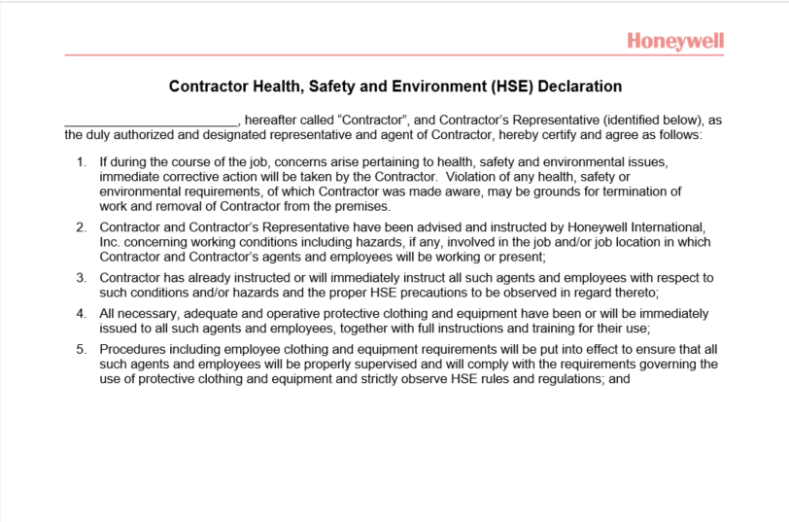
NSC-614-6792 Unclassified Unlimited Release

Slide 39
Section III
Construction Safety Requirements
For people working on activities identified as construction projects
NSC-614-6792 Unclassified Unlimited Release

Slide 40
Securing the Work Zone
All project sites must be protected to prevent unauthorized people from entering.
Caution tape, traffic cones, sawhorses, guard rails or portable screens must be in-place.
Barricade areas must be identified with some type of signage with a name and contact number.
NSC-614-6792 Unclassified Unlimited Release

Slide 41
Project Posting
All major construction projects require posting.
Project information centers should contain:
Telephone numbers for project contacts.
Project engineer’s name.
General contractor’s name.
Project name
NNSA and OSHA information.
NSC-614-6792 Unclassified Unlimited Release

Slide 42
Pre-Demolition Survey
Check utilities for support above and below ceiling or roof before demolition.
Ensure supports are adequate to prevent components from falling.
Contact area owner and ensure to barricade area underneath work before demolition.
NSC-614-6792 Unclassified Unlimited Release

Slide 43
Personal Protective Equipment (PPE)
Areas and operations throughout KCNSC require various kinds of PPE such as:
  Head Protection – Hard hats.
  Eye Protection – Safety glasses, goggles, and face shields.
  Fall Protection – Lanyards and shock absorbing harnesses, or retractable lifeline.
  Skin Protection – Gloves, suits, or High visibility shirt/vest when needed.
At a minimum, KCNSC requires Head and Eye protection for all construction activities.
NSC-614-6792 Unclassified Unlimited Release

Slide 44
Nuisance odors
All work involving materials that could potentially off gas, create excessive odors or dusts that could affect KCNSC Employees (interrupt daily activities) contact KCNSC Construction HS&E POC prior to notice to proceeding.
  Paints, caulks, solvents, cleaning solvents, and epoxies
NSC-614-6792 Unclassified Unlimited Release

Slide 45
Fall Protection
Fall protection is required:
Within 15 feet of an unprotected edge that is 4 feet or more above a lower level.
A fall protection harness/lanyard is required in any mobile elevated work platform such as scissor lift, vertical lift, boom lifts, cherry picker, ect.
Working off of pipes/duct
Contractors are responsible for ensuring anchor points are capable of supporting the fall protection system being used.
A fall protection rescue plan is to be established before work occurs.
NSC-614-6792 Unclassified Unlimited Release

Slide 46
Tools / Equipment
Only fiberglass ladders in good condition are to be used.
Portable power tools must be double insulated and GFCI protected.
All equipment and tools must be in good condition.
NSC-614-6792 Unclassified Unlimited Release

Slide 47
Electrical Safety, Requirements
Ground Fault Circuit Interrupters (GFCIs)
  Required on all cord and plug operated tools on construction sites.
Extension cords must be designed for hard or extra hard usage and be free of damage.
No flat cords are to be used at the KCNSC.
Arc flash protection (FR clothing) is required per NFPA 70 E
All installations will comply with National Electric Code (NEC).
NSC-614-6792 Unclassified Unlimited Release

Slide 48
Crane Use
All cranes must have a current inspection certification certificate and be in good condition.
All pick plans must be approved by KNCSC HS&E.
All hoisting and rigging equipment shall be properly maintained and inspected.
Areas under suspended loads must be clear at all times.
Clearance from overhead electrical lines must be maintained.
NSC-614-6792 Unclassified Unlimited Release

Slide 49
Fire Protection
All flammable liquids shall:
  Have storage approved by project engineer.
  Be stored in approved cans with flash arrestors.
    No plastic containers.
Hot work permits
  Required for welding, brazing, cutting, welding, any open flames, a spark producing operation, or using ordinary electrical equipment in an area with potential flammable vapors or in an electrically classified or hazardous area, or where ignition sources must be controlled through the use of a hot work permit.
  Required to be issued for each work shift.
  Issued by the building owner at KCNSC Main Campus.
  Issued by KCNSC HS&E at KCNSC East
  Hot work and fire watch training documentation required for hot work at KCNSC East.
NSC-614-6792 Unclassified Unlimited Release

Slide 50
Facilities Drain Systems
The KCNSC has 3 different drain systems
  Sanitary drains – sinks, toilets.
  Industrial waste – dilute industrial wastewater (acids, caustics).
  Storm drains – only rain water, nothing else.
It is important not to put anything down the drain systems unless you have approval to do so from your KCNSC contact.
NSC-614-6792 Unclassified Unlimited Release

Slide 51
Beryllium
Beryllium (Be) is used in some operations at the KCNSC.
Beryllium is:
  Naturally occurring metallic element.
  Often to strengthen copper.
  Lighter than aluminum
NSC-614-6792 Unclassified Unlimited Release

Slide 52
Beryllium Continued
At the KCNSC, beryllium has been used in a beryllium-copper alloy which is approximately 2% by mass.
Beryllium use is controlled in accordance with the DOE’s Chronic Beryllium Disease Prevention Program, 10 CFR 850.
NSC-614-6792 Unclassified Unlimited Release

Slide 53
Beryllium Continued
Over-exposure may cause Chronic Beryllium Disease (CBD)
  CBD is caused by inhalation exposure of beryllium particles.
  CBD causes inflammation and scarring in the lungs.
  CBD may take many years to develop.
  It can be mild or severe.
  It typically develops in about 1% of those exposed.
  It can be treated with medications that can slow its progress – if there are symptoms.
Questions regarding CBD or the beryllium program can be directed to x3181 or 816-488-3181.
NSC-614-6792 Unclassified Unlimited Release

Slide 54
Excavations
Any contact with soil (digging or grounding rods) requires approval from the building owner for Botts Campus or KCNSC for other sites.
Area to be worked will be reviewed for buried utilities before approval is given.
NSC-614-6792 Unclassified Unlimited Release

Slide 55
Building Penetrations
All building penetrations require approval by the building owner for Botts or KCNSC for other sites. The permitting is done by FES Construction Managers.
Penetrations include:
  Saw cutting, drilling, or jack-hammering into building roofs, walls, ceilings or floors, sidewalks, and roads.
NSC-614-6792 Unclassified Unlimited Release

Slide 56
KCNSC Required Permits
Hot work
Confined Space
Excavations
KCNSC Notice of Work (NOW)
Safe Work Permits
NSC-614-6792 Unclassified Unlimited Release

Slide 57
Section IV
KCNSC Lockout/Tagout (LOTO) Requirements
For contractors potentially exposed to hazardous energy.
Contractor must have completed their own company’s LOTO training program prior to performing LOTO at the KCNSC Facilities.
NSC-614-6792 Unclassified Unlimited Release

Slide 58
Lockout / Tagout (LOTO)
LOTO is required prior to servicing equipment where workers are exposed to hazardous energy:
  Electrical energy over 50 volts
  Gas pressure over 30 psi
  Water pressure over 100 psi
  Temperature below 35 or above 100F
  All gaseous nitrogen regardless of PSI
NSC-614-6792 Unclassified Unlimited Release

Slide 59
Lock Out / Tag Out Process
Only locks and tags identified specifically as LOTO equipment can be used for LOTO. KCNSC will provide locks, tags, and other LOTO equipment if needed. Contact your KCNSC representative.
All contractors will follow KCNSC’s lockout and tagout policy.
Each person issued locks and tags, is responsible for those items.
Each worker who is exposed to an energy source, must perform LOTO on that source, even if locked out by another person.
NSC-614-6792 Unclassified Unlimited Release

Slide 60
Section V
KCNSC Confined Space Entry Requirements
For workers who will enter posted confined spaces.
Contractors must complete their company’s OSHA compliant Confined Space training program and follow their companies KCNSC approved safety plan/AHA/Safe Work Permit to enter a confined space at a KCNSC Facility.
NSC-614-6792 Unclassified Unlimited Release

Slide 61
Confined Space Requirements
  Contractor shall use either KCNSC’s “KCD-2359 Entry Permit” or the contractor’s own KCNSC approved permit. Contact your KCNSC contract representative before entering any confined space.
NSC-614-6792 Unclassified Unlimited Release

Slide 62
Confined Space Requirements Continued
Contractors are responsible for providing Rescue Services and a means for atmospheric monitoring.
Confined spaces shall be tested for oxygen/combustible gases prior to entry by the contractor, and the entrant must wear gas monitor during entry. Contractor is responsible for testing monitoring.
Appropriate PPE is required – head protection, harness, retrieval rope and tripod.
Post the permit and air monitoring results at the entry point.
NSC-614-6792 Unclassified Unlimited Release

Slide 63
Confined Spaces Continued
Only trained persons can enter a confined space or be an attendant.
Perform a post-entry briefing to note any hazards not previously identified in the confined space.
NSC-614-6792 Unclassified Unlimited Release

Slide 64

Training Completion Validation
Please check the box next to the training you have completed:
  Section I KCNSC General HS&E Requirements.
  Acknowledge Contractor HSE Declaration
  Section II KCNSC Contractor Security Requirements.
  Section III KCNSC Construction Safety Requirements.
  Section IV KCNSC Lockout/Tagout (LOTO) Requirements.
  Section V KCNSC Confined Space Entry Requirements.
I certify that I have read the training checked above and will comply with the requirements identified in the training.
Company:________________________________ Soc. Sec. # Last 4 digits _________
Signature:____________________________ Date:__________
Print Name:______________________________________ (Please Print legibly)
Return to HS&E by email HSE@kcnsc.doe.gov, or have your host deliver it to the HSE lab in building 3 at 03.1.E06.D010 at the KCNSC.

